Slide 2
LEARNING OBJECTIVE
1. To study the angle sum property of a quadrilateral.
2. Study of various properties of parallelogram.
3. To verify mid-point theorem.
4. To verify converse of mid point theorem.
5. Application of mid-point theorem in quadrilateral.

Slide 3
INTRODUCTION
1.Four points in a plane such that no three of them are collinear, then the figure obtained by joining them in pairs is called a quadrilateral.
2.A quadrilateral is a polygon made up of four lines. It has four sides, four angles and four vertices.
3.The sum of angles of a quadrilateral is equal to 360⁰ .

Slide 4
Quadrilateral Basic Facts

Slide 5
DEFINATION: A quadrilateral is called a concave quadrilateral, if at least one line segment joining the vertices is not a part of the same region of the quadrilateral.
DEFINATION: A convex quadrilateral is a four sided polygon that has interior angles that measure less than 180 degrees each.

Slide 7
DEMONESTRATION WITH EXAMPLE

Slide 8
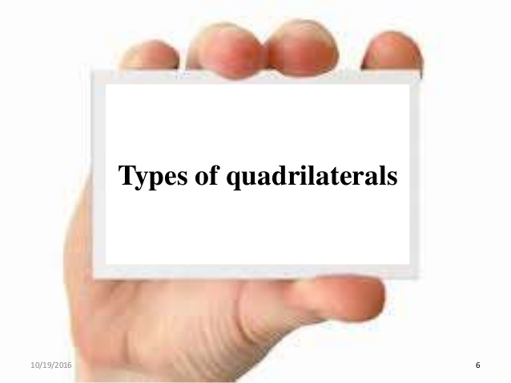

Slide 21
A diagonal of a parallelogram divides it into two congruent triangles.
.In a parallelogram opposite sides are equal.
If each pair of opposite sides of a quadrilateral are equal, then it is a parallelogram.
In a parallelogram opposite angles are equal.
If in a quadrilateral each pair of opposite angles is equal,then it is a parallelogram.

Slide 22
The diagonals of a parallelogram bisect each other.
If the digonals of a quadrilateral bisect each other, then it is a parallelogram.
A quadrilateral is a parallelogram,if a pair of opposite sides is equal and parallel.

Slide 23
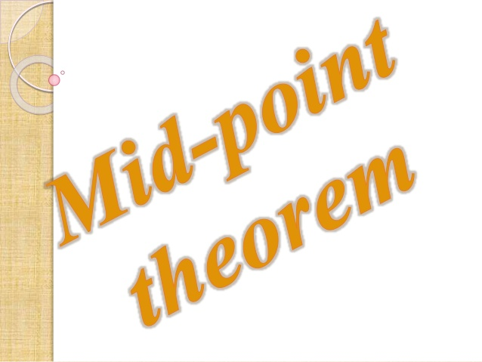

Slide 24
MID-POINT THEOREM AND CONVERSE
The line segment joining the mid-points of two sides of a triangle is parallel to the third sides.
The line drawn through the mid-point of one side of a triangle parallel to another side bisects the third side.

Slide 25
A
D
F
E
B
C

Slide 28
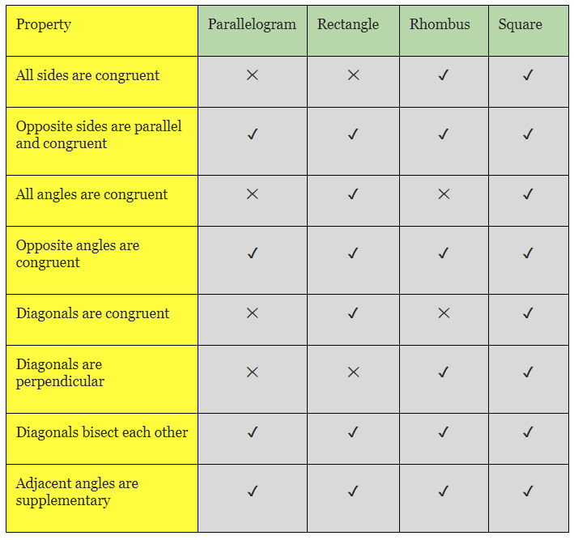
COMPARISION OF PROPERTIES

Slide 29
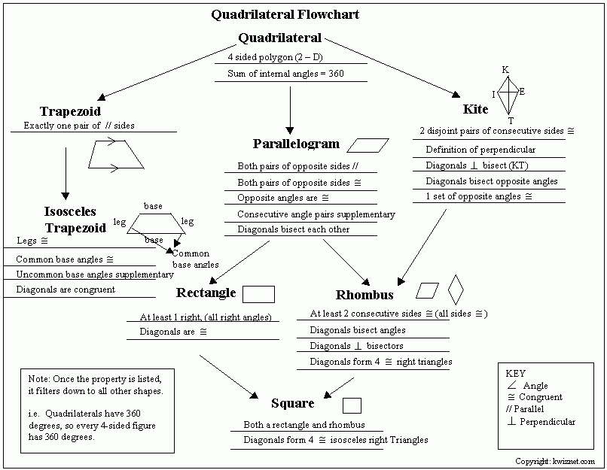

Slide 30
LEARNING OUTCOMES
1.Students are able to understand what is a quadrilateral.
2.They understood about angle sum property of a quadrilateral.
3.They enriched the properties of a quadrilateral.
4. They understood about the midpoint theorem and its converse part.

Slide 31
TEAM, DAV CDA, CUTTACK

